Slide 1
Defenza del examen hito4
Sarai leslie alvarez rosas

Slide 2
Parte 1 Diseño y emvio a otro activity

Slide 3
1.- Crear una carpeta con el number “Adapter” dentro crear las clases RVAdapter y el viewHolder
2.- Implementaremos las iguientes librerias
//recyclerview implementation 'com.android.support:preference-v7:29.0.0‘
//glyde for images implementation 'com.github.bumptech.glide:glide:4.11.0' annotationProcessor 'com.github.bumptech.glide:compiler:4.11.0‘
//Circle ImageView implementation 'de.hdodenhof:circleimageview:3.1.0

Slide 4
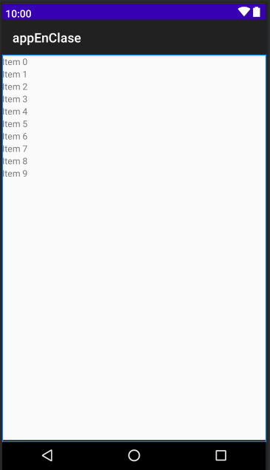
Dentro del activity_main.xml
<?xml version="1.0" encoding="utf-8"?> <RelativeLayout xmlns:android="http://schemas.android.com/apk/res/android" xmlns:app="http://schemas.android.com/apk/res-auto" xmlns:tools="http://schemas.android.com/tools" android:layout_width="match_parent" android:layout_height="match_parent" tools:context=".MainActivity"> <androidx.recyclerview.widget.RecyclerView android:id="@+id/rvContainer" android:layout_width="match_parent" android:layout_height="match_parent"> </androidx.recyclerview.widget.RecyclerView> </RelativeLayout>

Slide 5
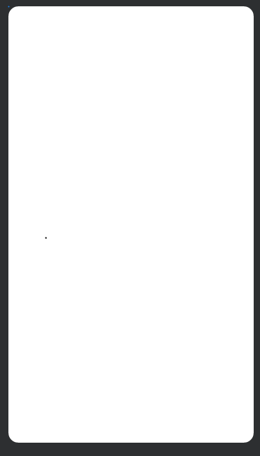
Para el diseño del botón creamos un nuevo drawable resourse file con el nombre de “cajas”
<?xml version="1.0" encoding="utf-8"?> <shape xmlns:android="http://schemas.android.com/apk/res/android"> <corners android:radius="16dp"/> <solid android:color="#ffffff"/> <stroke android:width="1dp" android:color="#ffffff"/> </shape>

Slide 6
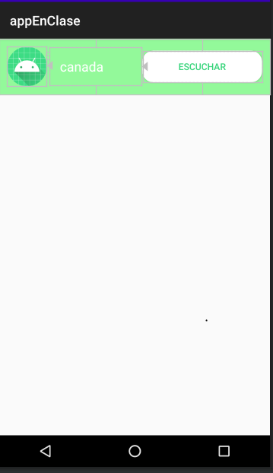
Dentro del la carpeta layout crearemos un nuevo layout resource file con el nombre de “rl_list_item.xml “ y empesaremos con el diseno
<?xml version="1.0" encoding="utf-8"?> <RelativeLayout xmlns:android="http://schemas.android.com/apk/res/android" android:id="@+id/rlListItem" android:layout_width="match_parent" android:layout_height="wrap_content" android:background="@color/verdeclaro" android:padding="12dp"> <de.hdodenhof.circleimageview.CircleImageView android:id="@+id/civItem" android:layout_width="60dp" android:layout_height="60dp" android:src="@mipmap/ic_launcher"/> <TextView android:id="@+id/tvImage" android:layout_width="140dp" android:layout_height="wrap_content" android:text="@string/canada" android:layout_marginStart="5dp" android:layout_toEndOf="@+id/civItem" android:layout_centerVertical="true" android:padding="15dp" android:textColor="@color/blanco" android:textSize="20sp"/> <Button android:id="@+id/btplay" android:layout_width="match_parent" android:layout_height="wrap_content" android:text="@string/escuchar" android:background="@drawable/cajas" android:layout_toEndOf="@id/tvImage" android:layout_centerVertical="true" android:textColor="@color/verdefuerte" /> </RelativeLayout>

Slide 7
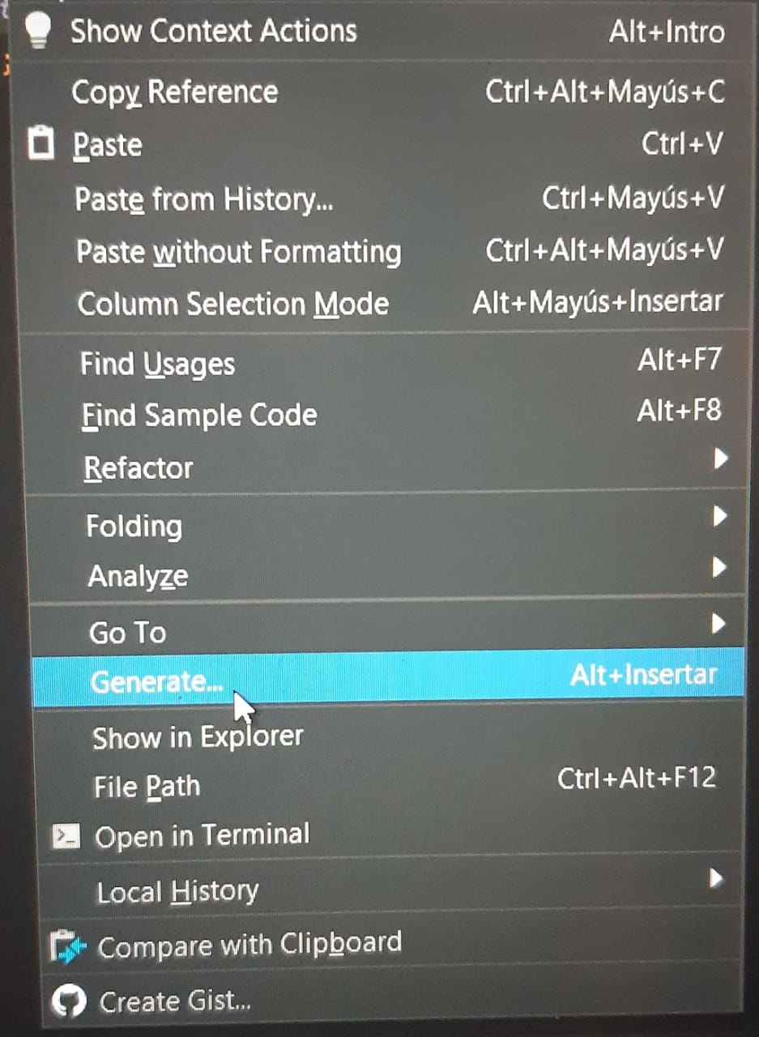
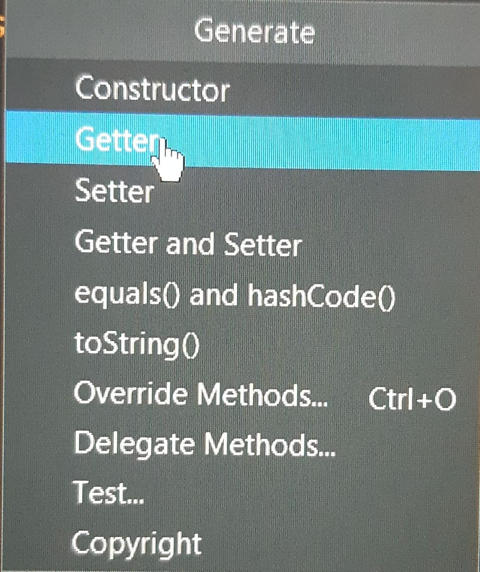
La clase ViewHolder es la accedera a nuestros componentes , a nuestr imagen t al texto , entonces dentro de esta clase pondremos.
public class ViewHolder extends RecyclerView.ViewHolder { private RelativeLayout rlContainer; private CircleImageView circleImage; private TextView tvImage; private Button boton; private void initComponents(View itemView) { rlContainer = itemView.findViewById(R.id.rlListItem); circleImage = itemView.findViewById(R.id.civItem); tvImage = itemView.findViewById(R.id.tvImage); boton=itemView.findViewById(R.id.btplay); } }
Hacer click derecho y presionar en generar
Precionar en getter y seleccionas

Slide 8
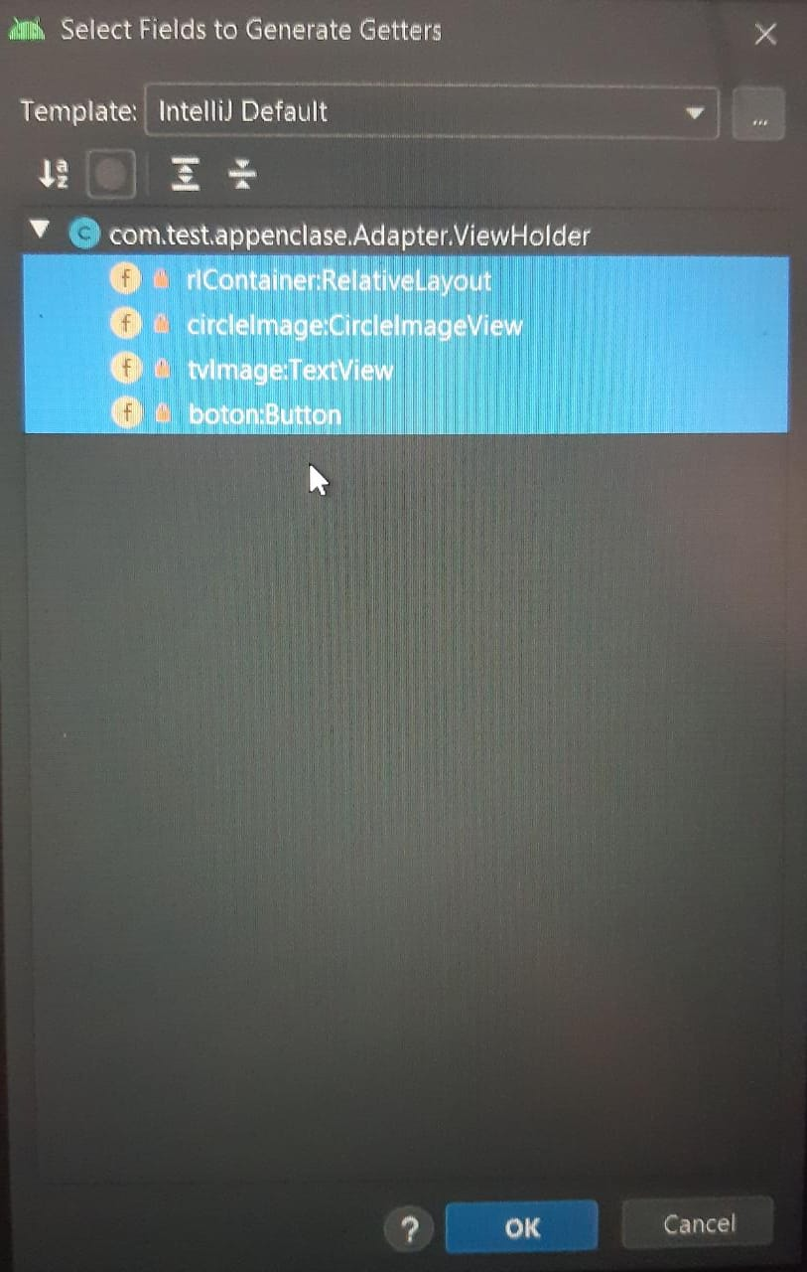
De esta forma se generaran los getter
public class ViewHolder extends RecyclerView.ViewHolder {//clase k accede a nuestro componente a la imagen y al texto private RelativeLayout rlContainer; private CircleImageView circleImage; private TextView tvImage; private Button boton; private void initComponents(View itemView) { rlContainer = itemView.findViewById(R.id.rlListItem); circleImage = itemView.findViewById(R.id.civItem); tvImage = itemView.findViewById(R.id.tvImage); boton=itemView.findViewById(R.id.btplay); } public ViewHolder(@NonNull View itemView) { super(itemView); initComponents(itemView); } public Button getBoton() { return boton; } public CircleImageView getCircleImage() { return circleImage; } public RelativeLayout getRlContainer() { return rlContainer; } public TextView getTvImage() { return tvImage; }}

Slide 9
Dentro del Main_Activity.java pondremos
almacenamos todos los nombres de las imagenes en una sola variable imgURL y imgnam
public class MainActivity extends AppCompatActivity { private RecyclerView recyclerView; private RVAdapter rvAdapter; private ArrayList<String> imagesName = new ArrayList<>(); private ArrayList<String> imagesURL = new ArrayList<>();
private final String imgURL = "V4OgA4O,yB3d2qH,9jMbaX2,rYndmdq,sypYnSP,HBeK1ot,YCqbt8r,eLk31XX,XzffKgy,4ZHp7FO,DJabk5C,XzffKgy";
private final String imgNam = "Playist 1,Playist 2,Playist 3,Playist 4,Playist 5,Playist 6,Playist 7,Playist 8, Playist 9,Playist 10,Playist 11,Playist 12"; @Override protected void onCreate(Bundle savedInstanceState) { super.onCreate(savedInstanceState); setContentView(R.layout.activity_main); initImageBitMaps(); initRecyclerView(); } public void initImageBitMaps() { imagesURL.addAll(Arrays.asList(imgURL.split(","))); imagesName.addAll(Arrays.asList(imgNam.split(","))); }
Agregamos dentro del array las imagenes y sus nombres

Slide 10
Dentro del RVAdapter
public class RVAdapter extends RecyclerView.Adapter<ViewHolder> { private static final String TAG = "RVAdapter"; private Context context; private ArrayList<String> imageNames = new ArrayList<>(); private ArrayList<String> imagesURI = new ArrayList<>(); public RVAdapter(Context context, ArrayList<String> imageNames, ArrayList<String> imagesURI) { this.context = context; this.imageNames = imageNames; this.imagesURI = imagesURI; } @Override public ViewHolder onCreateViewHolder(ViewGroup viewGroup, int viewType) { View view = LayoutInflater.from(viewGroup.getContext()).inflate(R.layout.rl_list_item,viewGroup,false); ViewHolder vHolder = new ViewHolder(view); return vHolder; }
@Override public void onBindViewHolder(@NonNull ViewHolder holder, final int position) { String URI = "https://i.imgur.com/"; Glide.with(context).asBitmap().load(URI+imagesURI.get(position) + ".png") .into(holder.getCircleImage()); holder.getTvImage().setText(imageNames.get(position)); holder.getTvImage().setOnClickListener(new View.OnClickListener() { @Override public void onClick(View v) { Toast.makeText(context,"my "+imageNames.get(position),Toast.LENGTH_SHORT).show(); } }); } @Override public int getItemCount() { //determina cuantos elementos tendra el listado return imageNames.size(); }

Slide 11
Dentro del Activity_main.java aumentaremos
public class MainActivity extends AppCompatActivity { private RecyclerView recyclerView; private RVAdapter rvAdapter; private ArrayList<String> imagesName = new ArrayList<>(); private ArrayList<String> imagesURL = new ArrayList<>(); //almacenamos todos los nombres de las imagenes en una sola variable imgURL y imgnam private final String imgURL = "V4OgA4O,yB3d2qH,9jMbaX2,rYndmdq,sypYnSP,HBeK1ot,YCqbt8r,eLk31XX,XzffKgy,4ZHp7FO,DJabk5C,XzffKgy"; private final String imgNam = "Playist 1,Playist 2,Playist 3,Playist 4,Playist 5,Playist 6,Playist 7,Playist 8, Playist 9,Playist 10,Playist 11,Playist 12"; @Override protected void onCreate(Bundle savedInstanceState) {.. .} public void initImageBitMaps() {.. .} public void initRecyclerView() { recyclerView = findViewById(R.id.rvContainer); rvAdapter = new RVAdapter(this, imagesName, imagesURL); recyclerView.setAdapter(rvAdapter); recyclerView.setLayoutManager(new LinearLayoutManager(this)); } }
Aumentamos

Slide 12
Dentro del RVAdapter para el cambio a otra pestana
public class RVAdapter extends RecyclerView.Adapter<ViewHolder> { private static final String TAG = "RVAdapter"; private Context context; private ArrayList<String> imageNames = new ArrayList<>(); private ArrayList<String> imagesURI = new ArrayList<>(); public RVAdapter(Context context, ArrayList<String> imageNames, ArrayList<String> imagesURI) {...} @Override public ViewHolder onCreateViewHolder(ViewGroup viewGroup, int viewType) {...} @Override public void onBindViewHolder(@NonNull ViewHolder holder, final int position) { String URI = "https://i.imgur.com/"; Glide.with(context).asBitmap().load(URI + imagesURI.get(position) + ".png").into(holder.getCircleImage()); holder.getTvImage().setText(imageNames.get(position)); holder.getTvImage().setOnClickListener(new View.OnClickListener() { @Override public void onClick(View v) { Toast.makeText(context,"my "+imageNames.get(position),Toast.LENGTH_SHORT).show(); } }); holder.getBoton().setOnClickListener(new View.OnClickListener() { @Override public void onClick(View v) { Intent inn = new Intent(context,PLAY1_P.class ); context.startActivity(inn); } }); } @Override public int getItemCount() {...} }
Aumentamos

Slide 13
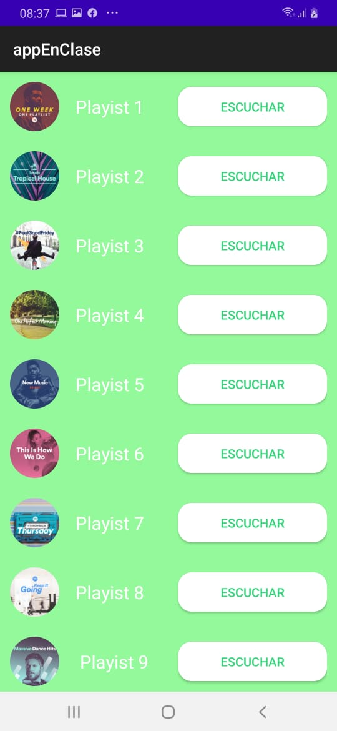
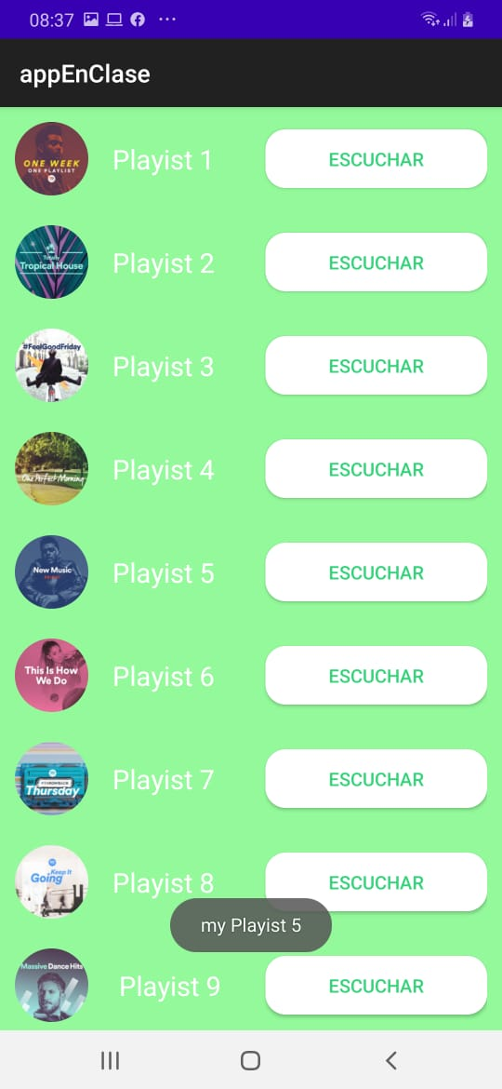
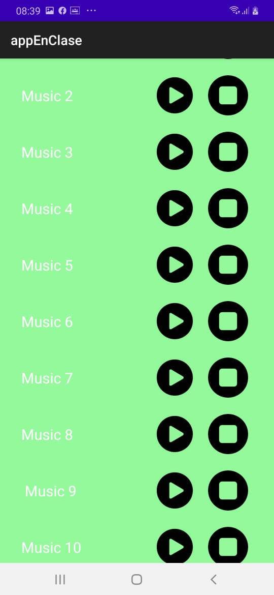
Resultado de la primera parte

Slide 14
Parte 2 Diseño y funcionalidad de los mensajes

Slide 15
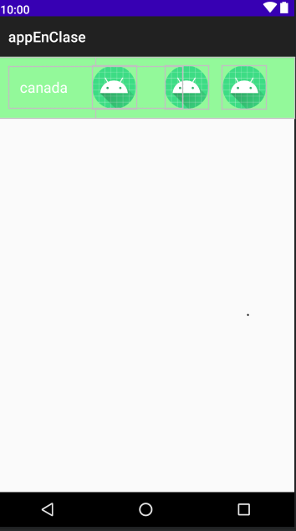
Dentro de play1.xml trabajaremos con el diseno
<?xml version="1.0" encoding="utf-8"?> <RelativeLayout xmlns:android="http://schemas.android.com/apk/res/android" android:id="@+id/rlListItemplay" android:layout_width="match_parent" android:layout_height="wrap_content" android:background="@color/verdeclaro" android:padding="12dp"> <TextView android:id="@+id/tvImage1" android:layout_width="240dp" android:layout_height="wrap_content" android:text="@string/canada" android:layout_marginStart="5dp" android:layout_centerVertical="true" android:padding="15dp" android:textColor="@color/blanco" android:textSize="20sp"/> <de.hdodenhof.circleimageview.CircleImageView android:id="@+id/reproducir" android:layout_width="60dp" android:layout_height="60dp" android:layout_marginLeft="220dp" android:src="@mipmap/ic_launcher" /> <de.hdodenhof.circleimageview.CircleImageView android:id="@+id/pausa" android:layout_width="60dp" android:layout_height="60dp" android:src="@mipmap/ic_launcher" android:layout_marginLeft="220dp" /> <de.hdodenhof.circleimageview.CircleImageView android:id="@+id/apagar" android:layout_width="60dp" android:layout_height="60dp" android:src="@mipmap/ic_launcher" android:layout_marginLeft="300dp" /> </RelativeLayout>
1.- Crear una carpeta con el number “carpetaplay” dentro crear las clases RVAdapter_paly1 y el viewHolderplay y un Nuevo empty_activity con el nombre ”PLAY_1”.
Dentro del layout creacremos un Nuevo Layout resource file con el nombre de “ paly1”

Slide 16
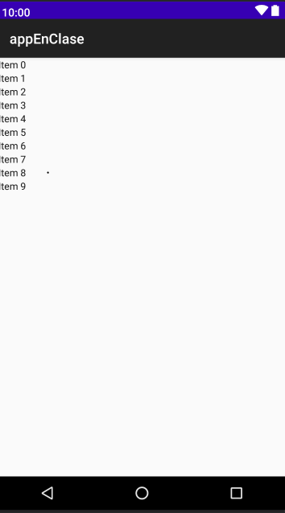
Dentro del Activity_p_l_a_y_1.xml pondremos el contenedor de la
<?xml version="1.0" encoding="utf-8"?> <RelativeLayout xmlns:android="http://schemas.android.com/apk/res/android" xmlns:app="http://schemas.android.com/apk/res-auto" xmlns:tools="http://schemas.android.com/tools" android:layout_width="match_parent" android:layout_height="match_parent" tools:context=".carpetaplay.PLAY1_P"> <androidx.recyclerview.widget.RecyclerView android:id="@+id/rvContainerREPRODUCIR" android:layout_width="match_parent" android:layout_height="match_parent">
</androidx.recyclerview.widget.RecyclerView>
<androidx.recyclerview.widget.RecyclerView android:id="@+id/rvContainerPAUSA" android:layout_width="match_parent" android:layout_height="match_parent">
</androidx.recyclerview.widget.RecyclerView>
<androidx.recyclerview.widget.RecyclerView android:id="@+id/rvContainerAPAGAR" android:layout_width="match_parent" android:layout_height="match_parent">
</androidx.recyclerview.widget.RecyclerView> </RelativeLayout>

Slide 17
Dentro del viewholderplay.java
public class viewholdeplay extends RecyclerView.ViewHolder{ private RelativeLayout rlContainer; private CircleImageView circleImage1; private CircleImageView circleImage2; private CircleImageView circleImage3; private TextView tvImage1; private void initComponents(View itemView) { rlContainer = itemView.findViewById(R.id.rlListItemplay); circleImage1 = itemView.findViewById(R.id.reproducir); circleImage2 = itemView.findViewById(R.id.pausa); circleImage3 = itemView.findViewById(R.id.apagar); tvImage1= itemView.findViewById(R.id.tvImage1); }
Hacer click derecho y presionar en generar
Precionar en getter y seleccionas

Slide 18
Le agregaremos
public class viewholdeplay extends RecyclerView.ViewHolder{ private RelativeLayout rlContainer; private CircleImageView circleImage1; private CircleImageView circleImage2; private CircleImageView circleImage3; private TextView tvImage1; private void initComponents(View itemView) { rlContainer = itemView.findViewById(R.id.rlListItemplay); circleImage1 = itemView.findViewById(R.id.reproducir); circleImage2 = itemView.findViewById(R.id.pausa); circleImage3 = itemView.findViewById(R.id.apagar); tvImage1= itemView.findViewById(R.id.tvImage1); } public viewholdeplay(@NonNull View itemView) { super(itemView); initComponents(itemView); } public RelativeLayout getRlContainer() { return rlContainer; } public CircleImageView getCircleImage1() { return circleImage1; } public CircleImageView getCircleImage2() { return circleImage2; } public CircleImageView getCircleImage3() { return circleImage3; } public TextView getTvImage1() { return tvImage1; }

Slide 19
Dentro del PLAY1_P.java pondremos
public class PLAY1_P extends AppCompatActivity { private RecyclerView recyclerView1,recyclerView2,recyclerView3; private RVAdapter_play1 rvAdapterPlay1; private ArrayList<String> imagesName = new ArrayList<>(); private ArrayList<String> imagesURLPLAY = new ArrayList<>(); private ArrayList<String> imagesURLPAUSA = new ArrayList<>(); private ArrayList<String> imagesURLAPAGAR = new ArrayList<>(); private final String imagesurlPLAY = "59AoTWq 2Nat0RQ,59AoTWq,59AoTWq,59AoTWq,59AoTWq,59AoTWq,59AoTWq,59AoTWq,59AoTWq,59AoTWq,59AoTWq,59AoTWq"; private final String imagesurlPAUSA ="2Nat0RQ,2Nat0RQ,2Nat0RQ,2Nat0RQ,2Nat0RQ,2Nat0RQ,2Nat0RQ,2Nat0RQ,2Nat0RQ,2Nat0RQ,2Nat0RQ,2Nat0RQ"; private final String imagesurlAPAGAR ="LJjdlQe,LJjdlQe,LJjdlQe,LJjdlQe,LJjdlQe,LJjdlQe,LJjdlQe,LJjdlQe,LJjdlQe,LJjdlQe,LJjdlQe,LJjdlQe"; private final String imagesNameee = "Music 1,Music 2,Music 3,Music 4,Music 5,Music 6,Music 7,Music 8, Music 9,Music 10,Music 11,Music 12"; @Override protected void onCreate(Bundle savedInstanceState) { super.onCreate(savedInstanceState); setContentView(R.layout.activity_p_l_a_y1__p); initImageBitMaps(); initRecyclerView(); } public void initImageBitMaps() { imagesURLPLAY.addAll(Arrays.asList(imagesurlPLAY.split(","))); imagesURLPAUSA.addAll(Arrays.asList(imagesurlPAUSA.split(","))); imagesURLAPAGAR.addAll(Arrays.asList(imagesurlAPAGAR.split(","))); imagesName.addAll(Arrays.asList(imagesNameee.split(","))); }
almacenamos todos los nombres de las imagenes en una sola variable imgURL y imgnam
Agregamos dentro del array las imagenes y sus nombres

Slide 20
Dentro del RVAdapter
public class RVAdapter_play1 extends RecyclerView.Adapter<viewholdeplay>{ private static final String TAG = "RVAdapter"; private boolean EO=false; private Context context; private ArrayList<String> imageNames = new ArrayList<>(); private ArrayList<String> imagesURIplay = new ArrayList<>(); private ArrayList<String> imagesURIpausa = new ArrayList<>(); private ArrayList<String> imagesURIapagar = new ArrayList<>(); public RVAdapter_play1(Context context, ArrayList<String> imageNames, ArrayList<String> imagesURIplay,ArrayList<String>
imagesURIpausa,ArrayList<String>imagesURIapagar) { this.context = context; this.imageNames = imageNames; this.imagesURIplay = imagesURIplay; this.imagesURIpausa = imagesURIpausa; this.imagesURIapagar = imagesURIapagar; } @Override public viewholdeplay onCreateViewHolder(ViewGroup viewGroup, int viewType) {View view = LayoutInflater.from(viewGroup.getContext())
.inflate(R.layout.play1,viewGroup,false); viewholdeplay vHolder = new viewholdeplay(view); return vHolder; } @Override public void onBindViewHolder(@NonNull final viewholdeplay holder, int position) { String URI = "https://i.imgur.com/"; Glide.with(context).asBitmap().load(URI + imagesURIplay.get(position) + ".png").into(holder.getCircleImage1()); holder.getTvImage1().setText(imageNames.get(position)); Glide.with(context).asBitmap().load(URI + imagesURIpausa.get(position) + ".png").into(holder.getCircleImage2()); Glide.with(context).asBitmap().load(URI + imagesURIapagar.get(position) + ".png").into(holder.getCircleImage3()); } @Override public int getItemCount() { return imageNames.size(); }
Concatenamos los links de las imagenes

Slide 21
public class RVAdapter_play1 extends RecyclerView.Adapter<viewholdeplay>{ private ArrayList<String> imagesURIapagar = new ArrayList<>(); public RVAdapter_play1(Context context, ArrayList<String> imageNames, ArrayList<String> imagesURIplay,ArrayList<String>
imagesURIpausa,ArrayList<String>imagesURIapagar) { this.context = context; this.imageNames = imageNames; this.imagesURIplay = imagesURIplay; this.imagesURIpausa = imagesURIpausa; this.imagesURIapagar = imagesURIapagar; } @Override public viewholdeplay onCreateViewHolder(ViewGroup viewGroup, int viewType) {View view = LayoutInflater.from(viewGroup.getContext())
.inflate(R.layout.play1,viewGroup,false); viewholdeplay vHolder = new viewholdeplay(view); return vHolder; } @Override public void onBindViewHolder(@NonNull final viewholdeplay holder, int position) { String URI = "https://i.imgur.com/"; Glide.with(context).asBitmap().load(URI + imagesURIplay.get(position) + ".png").into(holder.getCircleImage1()); holder.getTvImage1().setText(imageNames.get(position)); Glide.with(context).asBitmap().load(URI + imagesURIpausa.get(position) + ".png").into(holder.getCircleImage2()); Glide.with(context).asBitmap().load(URI + imagesURIapagar.get(position) + ".png").into(holder.getCircleImage3()); holder.getCircleImage1().setOnClickListener(new View.OnClickListener() { @Override public void onClick(View v) { Toast.makeText(context,"play music",Toast.LENGTH_SHORT).show();} }); holder.getCircleImage2().setOnClickListener(new View.OnClickListener() { @Override public void onClick(View v) { Toast.makeText(context,"pause music",Toast.LENGTH_SHORT).show();} }); holder.getCircleImage3().setOnClickListener(new View.OnClickListener() { @Override public void onClick(View v) { Toast.makeText(context,"stop music",Toast.LENGTH_SHORT).show();}}); } @Override public int getItemCount() { return imageNames.size(); }
Para enviar mensajes al hacer click

Slide 22
En PLAY1_P.java agregaremos
public class PLAY1_P extends AppCompatActivity { private RecyclerView recyclerView1,recyclerView2,recyclerView3; private RVAdapter_play1 rvAdapterPlay1; private ArrayList<String> imagesName = new ArrayList<>(); private ArrayList<String> imagesURLPLAY = new ArrayList<>(); private ArrayList<String> imagesURLPAUSA = new ArrayList<>(); private ArrayList<String> imagesURLAPAGAR = new ArrayList<>(); private final String imagesurlPLAY = "59AoTWq 2Nat0RQ,59AoTWq,59AoTWq,59AoTWq,59AoTWq,59AoTWq,59AoTWq,59AoTWq,59AoTWq,59AoTWq,59AoTWq,59AoTWq"; private final String imagesurlPAUSA ="2Nat0RQ,2Nat0RQ,2Nat0RQ,2Nat0RQ,2Nat0RQ,2Nat0RQ,2Nat0RQ,2Nat0RQ,2Nat0RQ,2Nat0RQ,2Nat0RQ,2Nat0RQ"; private final String imagesurlAPAGAR ="LJjdlQe,LJjdlQe,LJjdlQe,LJjdlQe,LJjdlQe,LJjdlQe,LJjdlQe,LJjdlQe,LJjdlQe,LJjdlQe,LJjdlQe,LJjdlQe"; private final String imagesNameee = "Music 1,Music 2,Music 3,Music 4,Music 5,Music 6,Music 7,Music 8, Music 9,Music 10,Music 11,Music 12"; @Override protected void onCreate(Bundle savedInstanceState) {. . .} public void initImageBitMaps() {. . .}
public void initRecyclerView() { recyclerView1 = findViewById(R.id.rvContainerREPRODUCIR); rvAdapterPlay1 = new RVAdapter_play1(this, imagesName, imagesURLPLAY,imagesURLPAUSA,imagesURLAPAGAR); recyclerView1.setAdapter(rvAdapterPlay1); recyclerView1.setLayoutManager(new LinearLayoutManager(this));
}

Slide 23
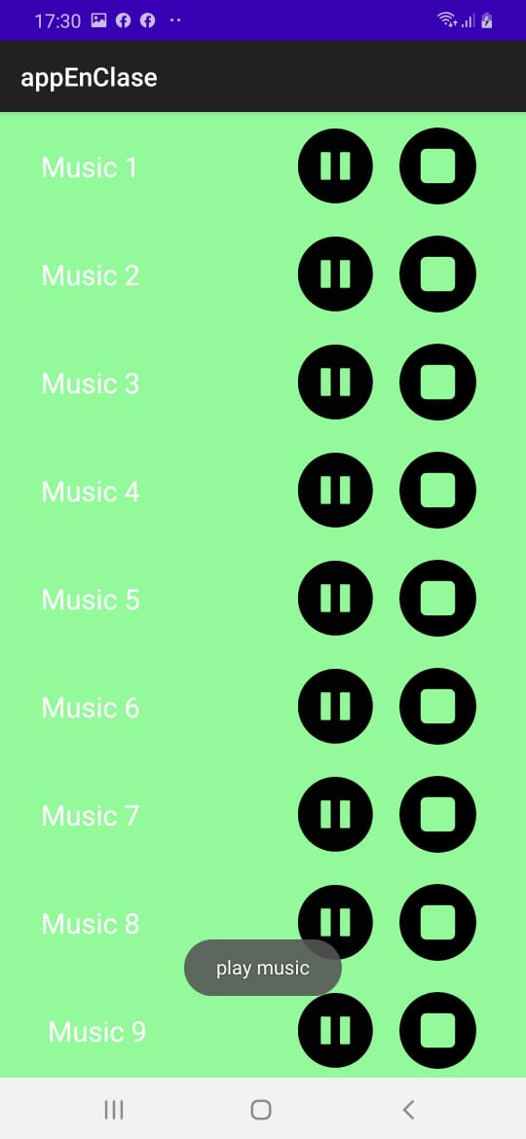

Slide 24
Parte 3 function del boton play y el stop

Slide 25
En el RVAdapter agregaremos
@Override public void onBindViewHolder(@NonNull final viewholdeplay holder, int position) { String URI = "https://i.imgur.com/"; Glide.with(context).asBitmap().load(URI + imagesURIplay.get(position) + ".png").into(holder.getCircleImage1()); holder.getTvImage1().setText(imageNames.get(position)); Glide.with(context).asBitmap().load(URI + imagesURIpausa.get(position) + ".png").into(holder.getCircleImage2()); Glide.with(context).asBitmap().load(URI + imagesURIapagar.get(position) + ".png").into(holder.getCircleImage3()); holder.getCircleImage2().setVisibility(View.INVISIBLE); holder.getCircleImage1().setOnClickListener(new View.OnClickListener() { @Override public void onClick(View v) { holder.getCircleImage1().setVisibility(View.INVISIBLE); holder.getCircleImage2().setVisibility(View.VISIBLE); Toast.makeText(context,"play music",Toast.LENGTH_SHORT).show(); } });
holder.getCircleImage2().setOnClickListener(new View.OnClickListener() { @Override public void onClick(View v) { holder.getCircleImage2().setVisibility(View.INVISIBLE); holder.getCircleImage1().setVisibility(View.VISIBLE); Toast.makeText(context,"pause music",Toast.LENGTH_SHORT).show(); } }); holder.getCircleImage3().setOnClickListener(new View.OnClickListener() { @Override public void onClick(View v) { Toast.makeText(context,"stop music",Toast.LENGTH_SHORT).show(); } }); }
Intercalamos la visibilidad de los botones visible e invisible

